Slide 1
Motor Condition Monitoring with IoT
Juan Constantine
Alivza Sontonojaya
游崴程

Slide 2
Background
Identifying the earliest warning signs of an impending breakdown is one of the most effective methods for manufacturers to reduce downtime, improve maintenance efficacy and boost overall productivity. How can facilities detect these signs early enough to make a difference? With motor condition sensors, which can closely track equipment performance and provide real-time alerts for even the smallest fluctuations in component functionality — early indicators that maintenance may be required soon.
Putting Data to Work for Improved Maintenance
Motor condition monitoring sensors are used for all types of rotating equipment, implementing detection practices such as motor vibration monitoring, temperature monitoring, vibration monitoring and more. A sensor-equipped motor health monitoring system can then help technicians investigate and address maintenance issues at low-impact times for the facility.
Motor condition monitoring tools can be used for any type of equipment that uses motors, including:
Pumps
Compressors
Fans
Blowers
Turbines
Gearboxes
Generators
And more

Slide 3
Purpose
Operational Benefits of Predictive Technology
Extended Machinery Life
By addressing maintenance issues before they lead to breakdowns, a motor condition monitoring system can help reduce or eliminate catastrophic failures — the type that produce massive and unplanned wear and tear on your equipment investments. By taking action when problems are just beginning, you can help extend equipment service life and lower your maintenance costs.
Reduced Maintenance Workload
Predictive maintenance is an effective supplement to scheduled preventive maintenance, but it also solves one of the primary inefficiencies of that tactic — namely, that with a preventive approach, maintenance issues are addressed only when they occur. In addition, predictive maintenance with motor condition monitoring facilitates early maintenance to solve potentially big problems, rather than the all-hands-on-deck scenarios that unplanned breakdowns often entail.
Streamlined Inventory Management
Motor condition monitoring with sensors provides a wealth of data that, over time, can give you a deep level of insight into your actual maintenance needs. With this data on hand, you can forecast inventory needs more accurately and efficiently. This can help reduce the number of “just in case” parts collecting dust on your shelves while ensuring that the spares you need are there when you need them.
Consistent Product Quality
Sensors for motor condition monitoring are designed to detect even the smallest fluctuations in equipment performance — fluctuations that, even if they don’t lead to maintenance events, could lead to variance in part consistency and quality. By drawing on real-time and historical sensor data, your facility can fine-tune operations to increase quality levels, streamline QC and add value for customers.

Slide 4
Industries Served
Industries Served
Focused, yet flexible across multiple industries
Our MRO and outsourced industrial maintenance services focus on eight key industries across manufacturing. With this expertise on hand, we are ready to adapt to new industries, production assets and manufacturing environments. With over three decades of experience, we are uniquely equipped to address your manufacturing and maintenance challenges to improve operational productivity.
Aerospace
Automotive
Building Products
Heavy Equipment
Consumer Packaged Goods
Paper & Pulp
Power Distribution
Tire and Rubber

Slide 5







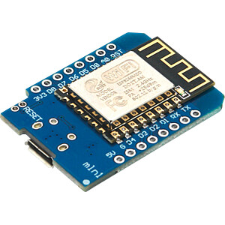

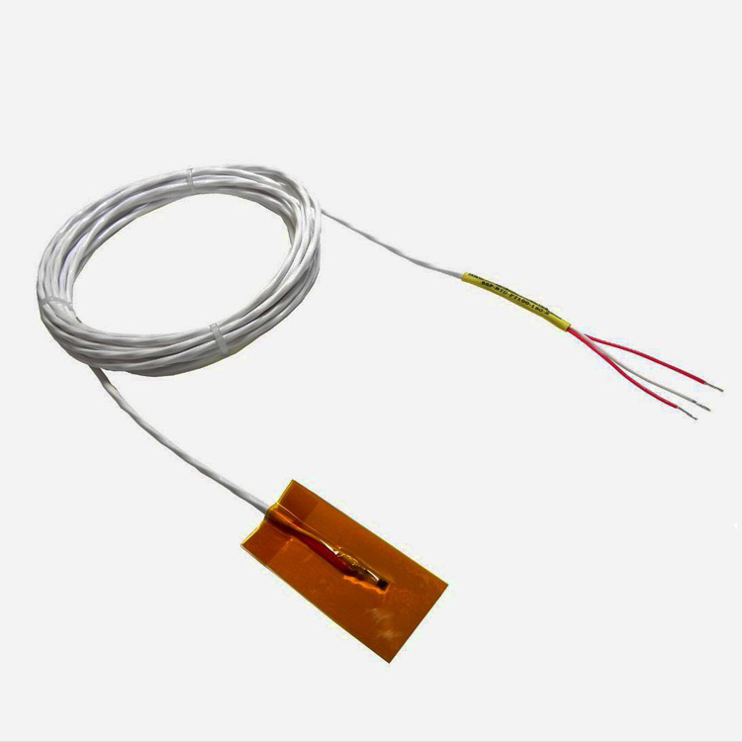
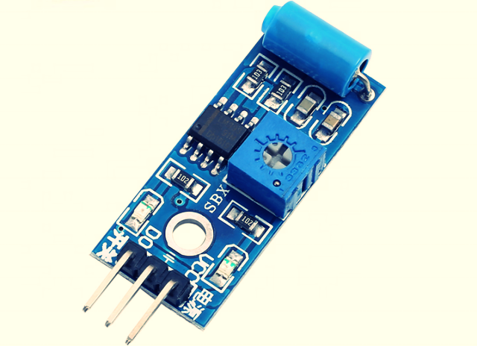
System
Cloud
Fog Computing
Telegram
ESP8266
End Devices
Temperature Sensor
Blynk
Vibration Sensor

Slide 6
SW-420 Vibration Sensor

Slide 7
Wemos D1 Mini

Slide 8
Temperature Sensor: RTD /PT100

Slide 9
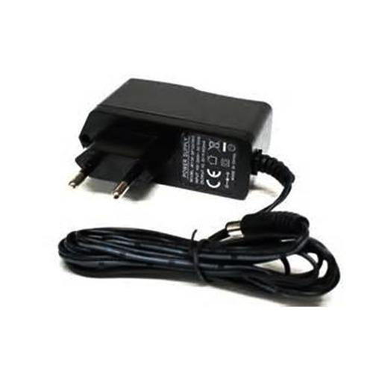
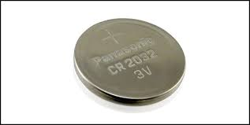
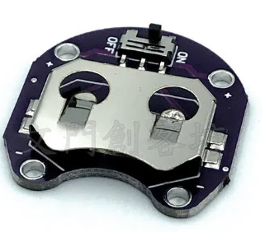
Power supply / Battery

Slide 10
Bill of Materials
No. | Parts | Price (NTD)
1 | SW-420 Vibration Sensor | 40
2 | Wemos D1 Mini | 100
3 | RTD/PT100 | 160
4 | Battery & Battery Socket | 40
5 | Small Box | 50
6 | Others (Cable, etc) | 100
7 | Motor | -

Slide 11
Hardware: Juan
Programming: Juan, 游崴程, Ali
Github: 游崴程
Website: Ali
Report: Ali
Presentation: 游崴程

